Slide 1
The Future of The Priors School
Parents Briefing

Slide 2
What is The Priors School?
Free schools are funded by the government but are not run by the local authority. We have more control over how we do things.
We are ‘all-ability’ schools, so can not use academic selection processes like a grammar school.
Free Schools are classed as Single Academy Trusts
We are registered on Companies House as a company
We have charity exemption status
We have to follow all rules set by the DfE and ESFA – the same rules as a MAT

Slide 3
Where are we now?
Strong data position
Strong, stable staffing position
Meetings with the Regional Schools Commissioner and DfE
Positive financial audits – school moved out of a deficit position
Positive improvements to school site
Good Ofsted

Slide 4
Ofsted Feedback
Very positive
We remain a good school – Securely good
“school’s curriculum is well developed in most subjects” and that “pupils’ knowledge and skills are developed consistently well over time.”
Children “experience an education that helps them to become confident and self-reliant learners” and that we “value their individuality. Pupils rise to these expectations and their personalities shine through.”
Children are “happy and confident” and their behaviour is “exemplary”.
“school has a family feel” and that we care “for pupils’ wellbeing.”
Governors are “committed to helping the school provide the best quality of education”
The children are “at the centre of all decisions” we make

Slide 5
Why do we need to consider change?
Government agenda – all Single Academy Trusts (SAT) to consider joining a Multi-Academy Trust (MAT)
Government White Paper wants to create “A fully trust led system with a single regulatory approach” and “By 2030, all children will benefit from being taught in a family of schools, with their school in a strong multi academy trust or with plans to join or form one”
DfE and Regional Schools Commissioner Conversations
Financial pressures on schools

Slide 6
What is a Multi-Academy Trust (MAT)
A MAT is a Multi-Academy Trust. It is a legal entity that governs a group of schools through a single set of directors. It is set up by a group of schools, usually a local collaboration, that share a common ethos and vision.

Slide 7
What have we done so far?
In 2019/2020 we began the process of due diligence with Stowe Valley MAT (Southam College).
During due diligence we decided that this was not the best fit MAT for us.
What they offer was great, but The Priors is a little different and we would have had to give up more than we wanted to.
Began looking again at the end of 2021 and made contact with 5 different MATs in early 2022
Narrowed this down to two different MATs and held various meetings and discussions
May 2022, the governors and I agreed that The Warriner MAT appears to be the best fit for us, so are now beginning the process of due diligence.

Slide 8
Why The Warriner MAT?
Well-established MAT
Featured in DfE best practice documentation and a DfE Case study about school improvement
They are a National Centre of Excellence for inclusion
Geographic area (30 mins away)
Other small schools – they support small schools and know how important they are to their communities
Experienced CEO
Flexible Scheme of Delegation
Opportunities for staff – training, working with colleagues
Individuality for schools
Alignment of values
We can be an asset and this is valued and recognised

Slide 9
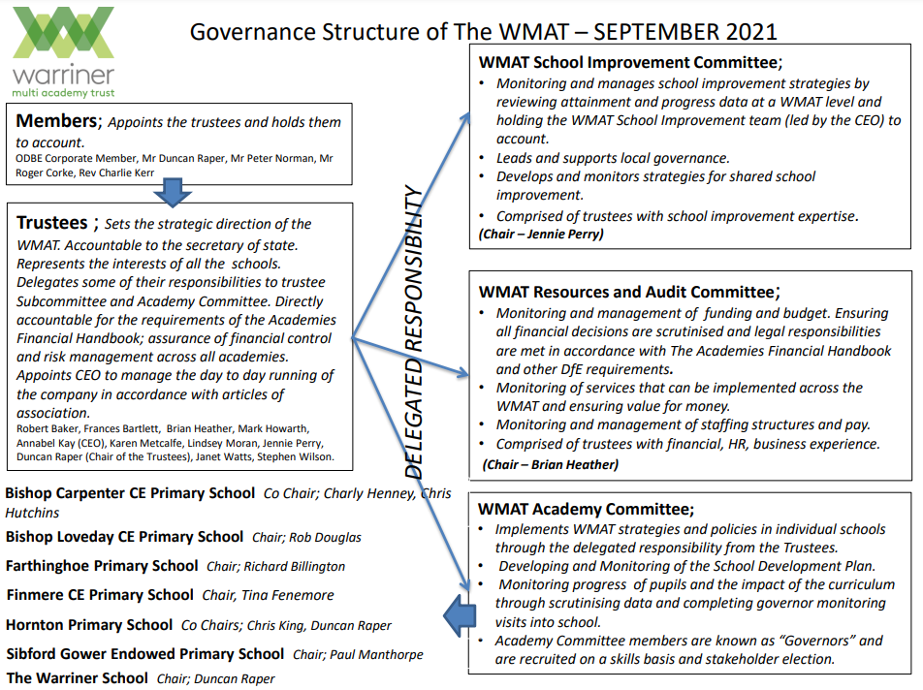
How is the MAT structured?

Slide 10
What does it mean for us?
There is a focus on schools maintaining their own identity – We would remain The Priors School
Can keep our own staffing structure, budgets and “The Priors way”
Opportunities for children to access specialist resources and teachers
Opportunities for children to work with other children
Support for middle leaders and phase teams with joint meetings
Support for heads and governors
Shared CPD for all staff
Potential opportunities for staff to develop and growth
Potential investment in the school site and access to larger pots of money

Slide 11
Next steps
Informal consultations - Staff, parents and local stakeholders
Due diligence – Us to Warriner and Warriner to us
Ratify the decision
Inform the Regional Schools’ Commissioner and DfE
Work with Warriner to transfer to the MAT
Join the MAT for September 2023

Slide 12
What due diligence will take place?
Values and ethos
Leadership
Finances
Staffing and contracts
Land and buildings
Data and attainment
Capacity
This goes both ways – Warriner looking at us and us looking at them

Slide 13
Informal Consultation
This begins the consultation about joining the MAT for parents.
Questions and comments to be brought to me or the governors to respond to – can be emailed, but we will leave a comments box in the entrance lobby.
We have a MAT section on the school website with all questions and answers published.
Parent consultation to close 5th September 2022

Slide 14
FAQs
We have FAQs on the school website. Some key questions:
Will the school keep the money it raises for itself?
Does being part of a MAT help The Priors with compliance?
Why are you only looking at one MAT?
Will The Priors maintain control of its own staffing?
Does this impact on our children going to Southam College?

Slide 15
Questions
Any questions for the governors, myself or Dr Kay?

