Slide 1
Whitemoor Lakes Residential Visit
Monday 2nd June – Friday 6th June 2025

Slide 2
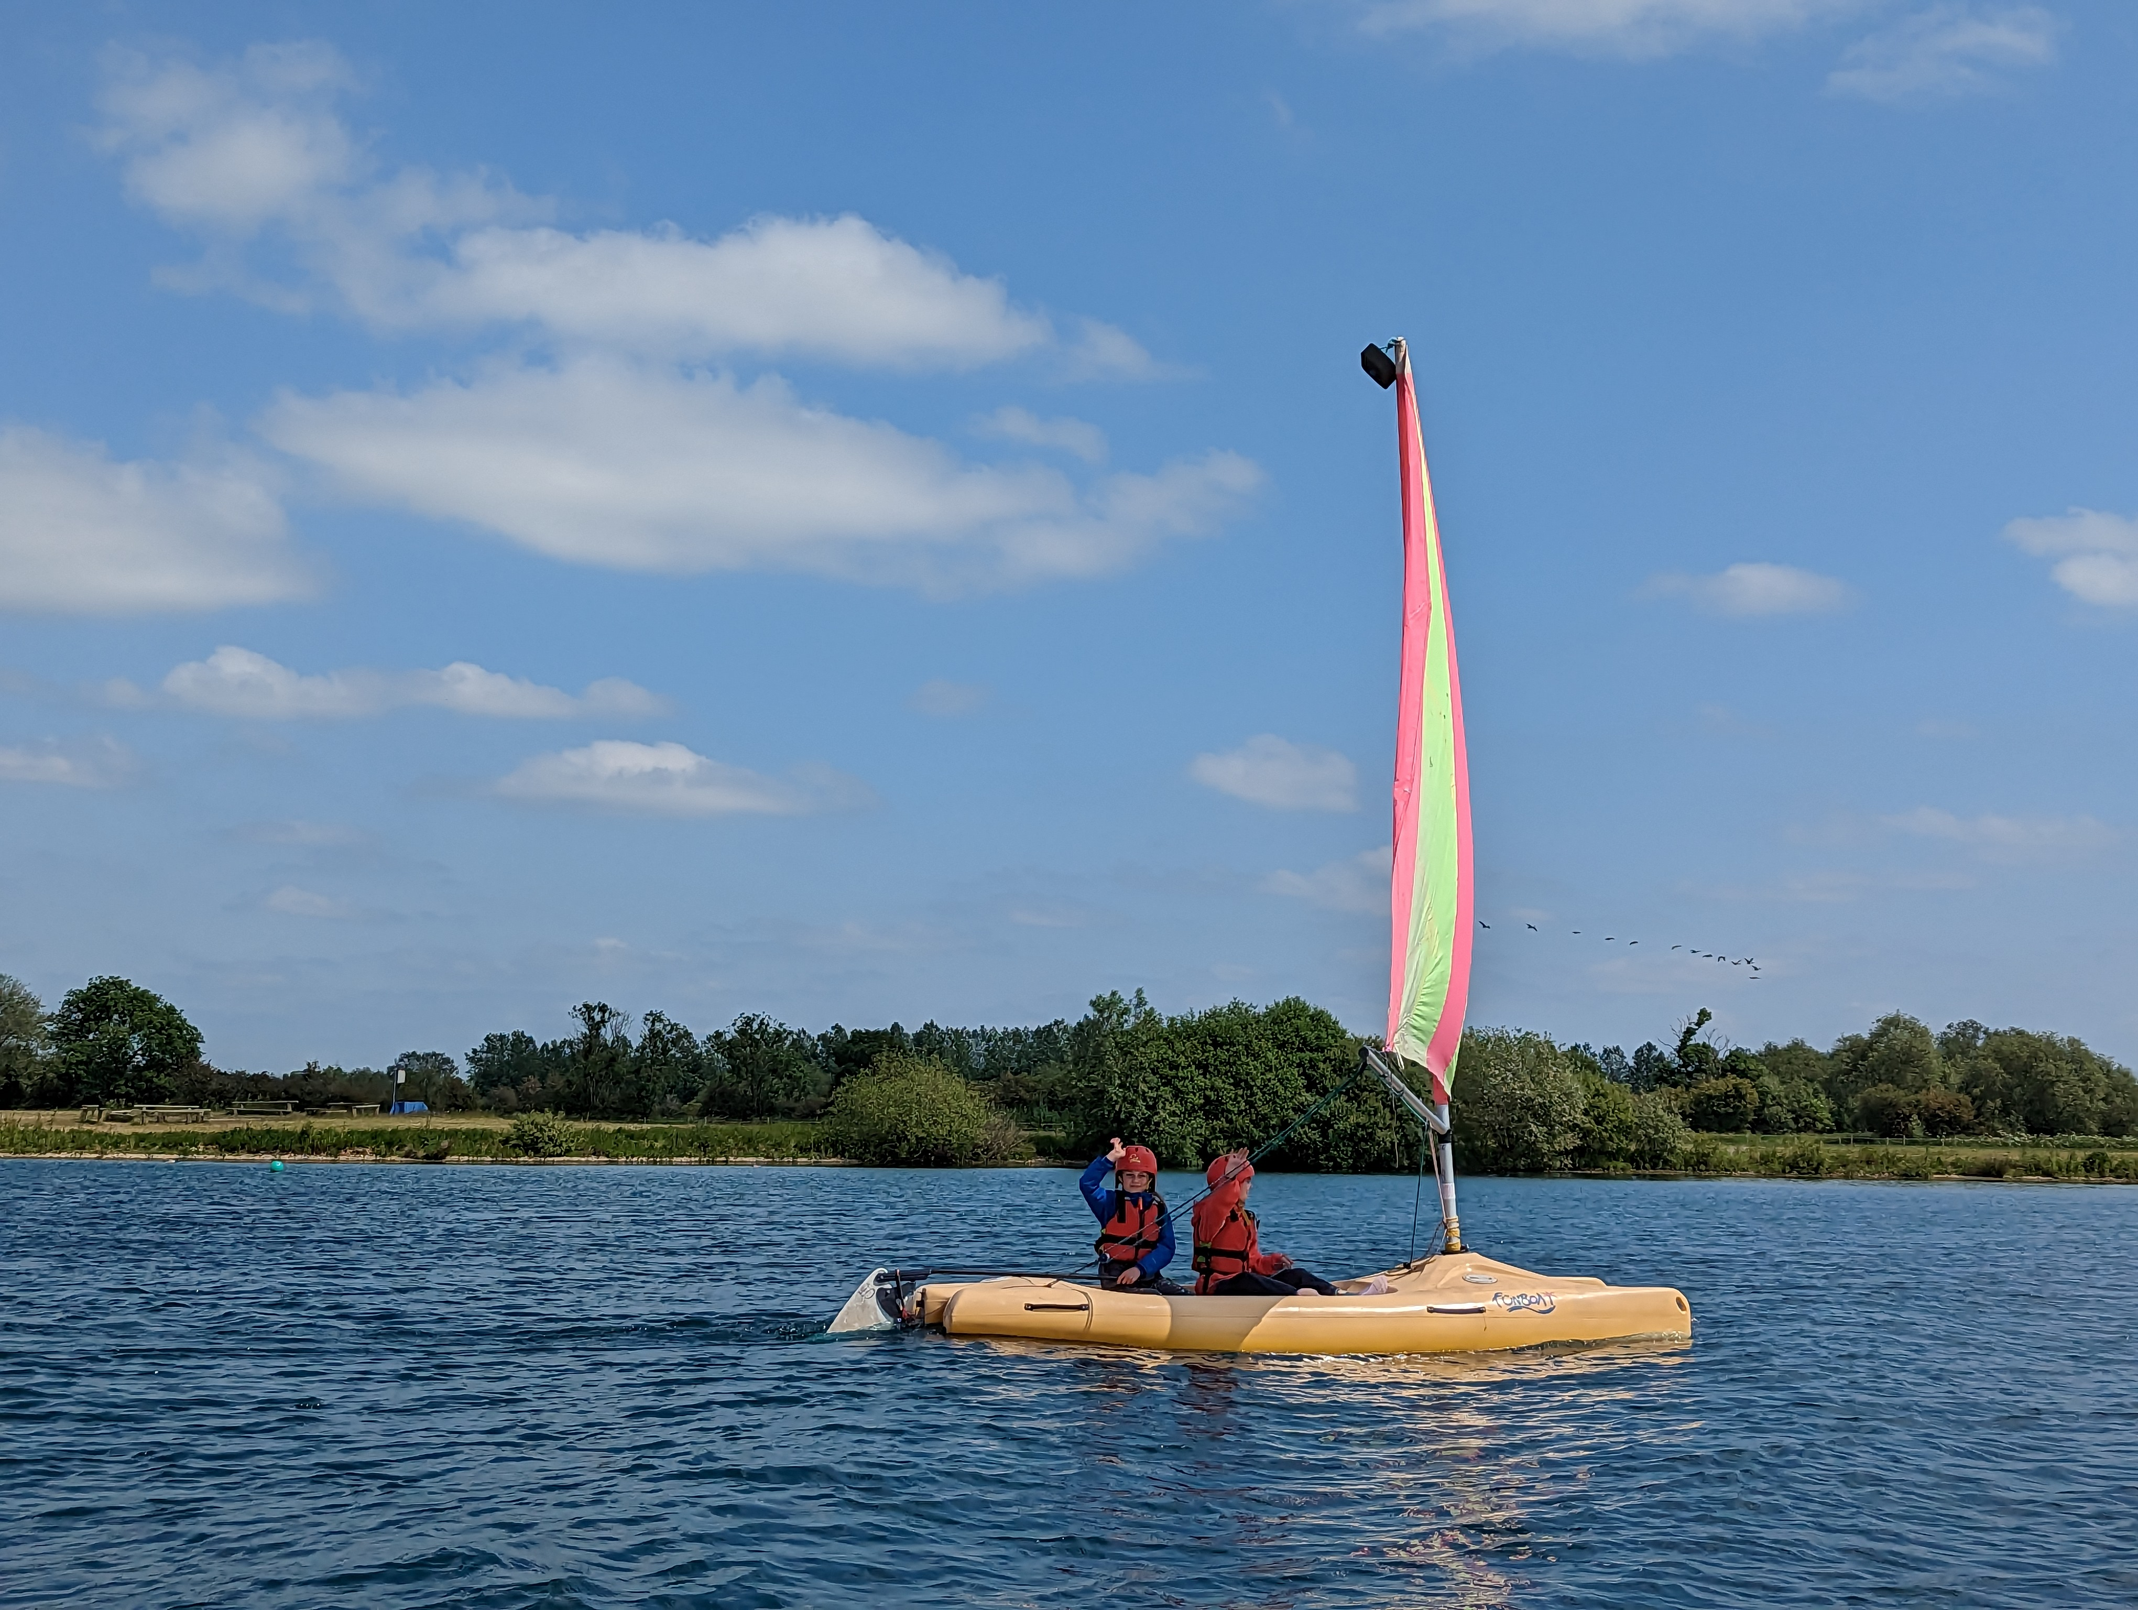
Year 5 and 6 residential visit
Risk taking and pushing beyond barriers
Real adventures
Independent living

Slide 3
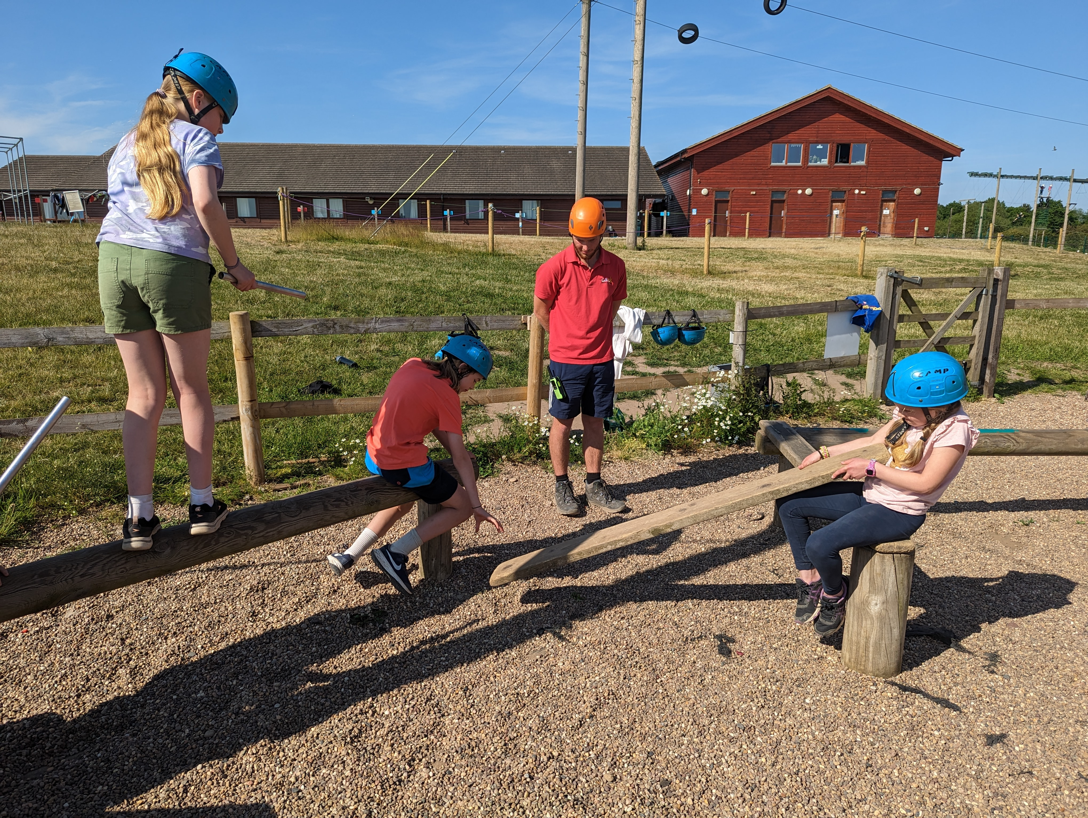
Where are we going?
Whitemoor Lakes is a residential outdoor education centre situated in Staffordshire.
Friendly, welcoming and experienced staff
A wonderful location
Experiential learning and personal and social development

Slide 4
Why are we going?
Their ethos is:
Respect
Teamwork
Challenge
Responsibility
These are things we all want from our
children

Slide 5
The centre
Dining Room – very good selection of food and great catering for children with additional dietary needs.
Bedrooms – Sleep between two and 10 people. Staff spread between the children.
Cloakroom, and drying room.
Our own dedicated lodge with our own common room.
Equipment – specialist equipment that is fully safety checked

Slide 8
Sample Timetable
 | Monday |  |  |  | Tuesday |  |  |  |  | Wednesday |  |  |  |  | Thursday |  |  |  |  | Friday
 | 11.00 | 2.00-3.30 | 4.00-5.30 | 7.00-8.00 | 9.30-11.00 | 11.00-12.30 | 2.00-3.30 | 4.00-5.30 | 7.00-8.00 | 9.30-11.00 | 11.30-1.00 | 2.00-3.30 | 4.00-5.30 | 7.00-8.00 | 9.30-11.00 | 11.30-1.00 | 2.00-3.30 | 4.00-5.30 | 7.00-8.00 | 9.30-11.00 | 11.30-1.00 | 2.00
Group 1 | Arrive & Welcome | Zipwire 1 | Archery 1 | Extreme Teams | Canoeing 1 | Challenge Course 1 | Climbing 1 | Raft Building 1 | Campfire 1 | Leap of Faith 2 | Orienteering 1 | Giant SUP 1 | Buggy Building 1 | Disco | Abseiling 1 | Traverse 1 | Problem Solving 1 | Gladiator 1 | Night Walk 1 | Sailing 1 | Team Games | Depart & Goodbyes
Group 2 |  | Leap of Faith 2 | Zipwire 1 |  | Archery 1 | Canoeing 1 | Challenge Course 1 | Climbing 1 |  | Raft Building 1 | Orienteering 2 | Sailing 1 | Giant SUP 1 |  | Buggy Building 1 | Abseiling 1 | Traverse 1 | Problem Solving 1 |  | Gladiator 1

Slide 9
Organisation
2 (possibly 3) school adults
Dates – Monday 2nd June 2025 – Friday 6th June 2025
Coach
Cost £430 per pupil – spread the cost throughout 18 months
PE Premium Subsidy of £1000
PET grant application – for families requiring additional support

Slide 10
Declaration of interest
Please complete the interest form and return to school by 15th October
We will set up the payment item on Parent Pay. Please keep up to date with payments as we have to pay Whitemoor Lakes periodically.
You can part pay this throughout the year, although we will need a deposit of £30 by 27th October 2023.
Balance to be paid by 21st April 2025.
Financial assistance – please do come and speak to us.

