Slide 1
Reading at The Priors School
Parents Meeting
23rd September 2024

Slide 2
Reading
Do you know why reading is important?
Do you look forward to reading at home?
Do you know how to help you child develop their reading ability?
Do you know how to help improve your child’s understanding of a text?
Are you aware of the different types of reading we do at school?

Slide 3
The ‘POWER’ of reading
Creating a love of reading in children is potentially one of the most powerful ways YOU can help your child.
Experts in literacy are unanimous in their belief that parents should read with their children.
The power of the parent-child bond has a positive effect on a child’s attitude towards reading and their ability to read.

Slide 4
Why is reading important?
Creating a love of reading in children is potentially one of the most powerful ways of improving academic standards in school.
There can be few better ways to improve pupils chances in school, or beyond in the wider world than to enable them to become truly independent readers.
Success in reading is fundamental to success in school
Reading is all about acquiring meaning; for enjoyment, information and understanding.

Slide 5
What is reading?
Reading requires two skills
Phonics and Word Recognition
The ability to blend letter sounds (phonemes) together to read words.
The ability to recognise words presented in and out of context.
Understanding
The ability to understand the meaning of the words and sentences in a text.
The ability to understand the ideas, information and themes in a text.
If a child understands what they hear, they will understand the same information when they read.

Slide 6
Reading in school
Phonics
Shared reading
Paired reading
Independent reading
Focused reading activities
Reading across the curriculum
Class novels and stories
The hearing of reading is NOT the teaching of reading

Slide 7
Phonics
Monster Phonics is an enhanced systematic synthetic phonics scheme.
It teaches phonics in a comprehensive structured progression but provides additional multi-sensory support to make learning more memorable and engaging.
It uses colour coding and monster sound cues to support learning when children encounter long vowels, silent letters, and tricky letters.
This additional support is used consistently and then cleverly phased out, creating confident independent readers.
It’s not just about the colours; the monsters themselves each represent a sound which brings phonics to life. This creates engagement, and speeds up the learning process for everyone.

Slide 8
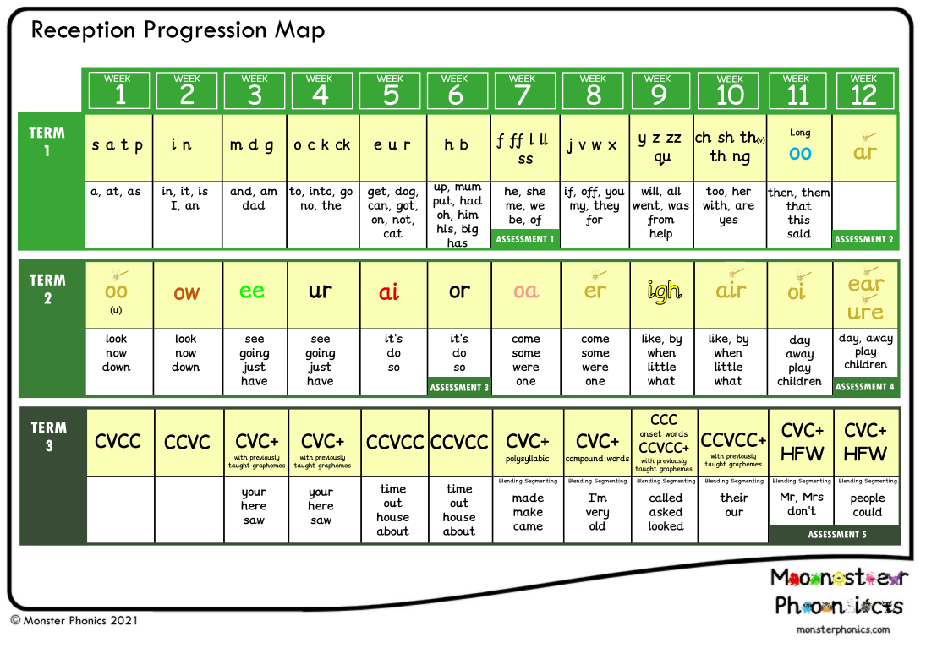
Reception

Slide 9
Year 1

Slide 10
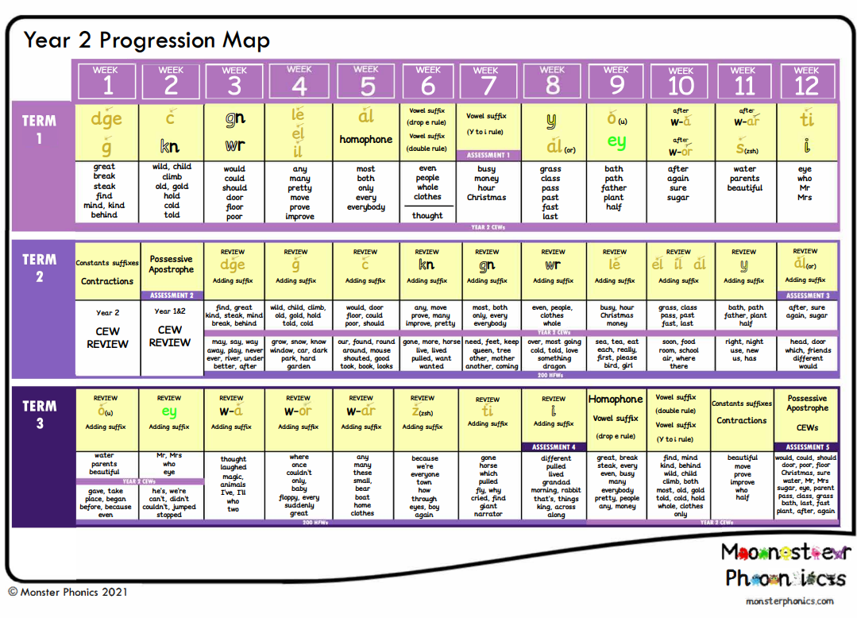
Year 2

Slide 11
Department for Education Reading Framework
A systematic phonics programme includes sufficient ‘decodable’ books or texts, so that children can practise, at school and at home, their increasing knowledge of GPCs and their blending skill in meaningful contexts.
‘Decodable’ books and other texts make children feel successful from the very beginning.
They do not encounter words that include GPCs they have not been taught.
If an adult is not present, they are not forced to guess from pictures, the context, the first letters of a word or its shape (see Appendix 7: Decodable texts for examples).
‘Decodable’ books and texts that children read should run alongside or a little behind the teaching of the GPCs, so that they always feel a sense of achievement when they are asked to read such books.
It is important that children practise their reading with ‘decodable’ books or texts.
They speed up the time they need to gain sufficient accuracy to read a wide range of children’s literature. It is helpful, therefore, if teachers explain to families how they can help their children to read such books when they bring them home.

Slide 12
What does this mean for us?
Slow down the access to the Monster Phonics Books
It is not a race to get to the end
We will only release books after the GPCs have been taught
We will release them in blocks
It is good to repeat books – it helps to develop fluency and automaticity
It is not slowing your child’s learning down – it is securing their learning and building on foundations.
Your children should be able to read most of the words in the books that come home

Slide 13
Reading for pleasure
Reading for pleasure is just as important as learning to read
Enjoying a story is one of the best things a child can do for developing a love of reading
The Monster Phonics books are great for teaching phonics and decoding skills, but the stories are short
We want children to enjoy books and not just see them as a task to complete

Slide 14
Class lists
Robins children do not have a set list, but we do have a large selection of books for them to access in the school day
Starlings have a selection of 120 books to read and enjoy over a two year period
Kingfishers and Owls have a selection of 100 books in each class to read and enjoy over a two year period

Slide 15
Robins and Starlings
Should my child be able to read the reading for pleasure books independently? The answer to this is NO
There is no expectation of your child being able to read the entire book.
They may be able to read words, use pictures to predict or talk to you about the story
These books are for you to share with your children. They are for you to read with them and enjoy them.
We have selected a range of high quality texts for you children to access

Slide 16
Kingfishers and Owls
These books are high quality texts which have been carefully chosen.
We would expect most children in these classes to read these books independently
We know children in these classes love to read in their heads
It is still great to listen to your children read even if it is a page or two
You could do a “book club” with your child - read it together and talk about it
Check your children are reading and understanding the text
It is not a race to the end!

Slide 17
My child struggles with reading
We know that children do not learn at the same rate
If your child does not pick up the phonics sounds quickly, we will put in interventions to help
Your child may move through the books more slowly
Your child may repeat Monster Phonics books they have already read
We may select other books not on the list to support your child
If we have concerns we will talk to you!

Slide 18
My child is a great reader – are you holding them back?
The simple answer to this is no
The curriculum is clear that we need to keep the books matching the GPCs the children have been taught
The structure of the phonics programme is clear and we need to teach the sounds in a progressive way
Your children should not struggle with the Monster Phonics books and you should not need to help them too much
If your children are really fluent – it is good to practice again and push for understanding
The Monster Phonics books have questions at the end of the books to help with this

Slide 19
How can you help your child?
Reinforce phonics sounds
Read with you child daily
Make it fun
Get caught reading
Read different texts
Give lots of encouragement
Read to your child
Ask lots of questions

Slide 20
Time for questions

